Slide 1

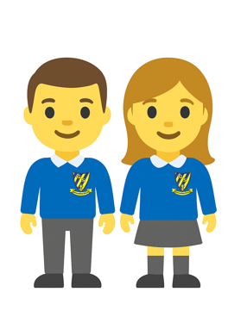
Fieldwork Fortnight at Gwladys Street
We are Gwladys Street Geographers!

Slide 2
Why?
Fieldwork is an important part of primary geography because it allows children to explore and understand the world around them through direct experiences. It helps make learning more meaningful by developing observation, questioning, problem-solving, and practical skills. Fieldwork encourages teamwork, independence, and curiosity while helping children connect classroom knowledge to real places and environments. These experiences can improve understanding, build confidence, and inspire a greater awareness and appreciation of the world.

Slide 3
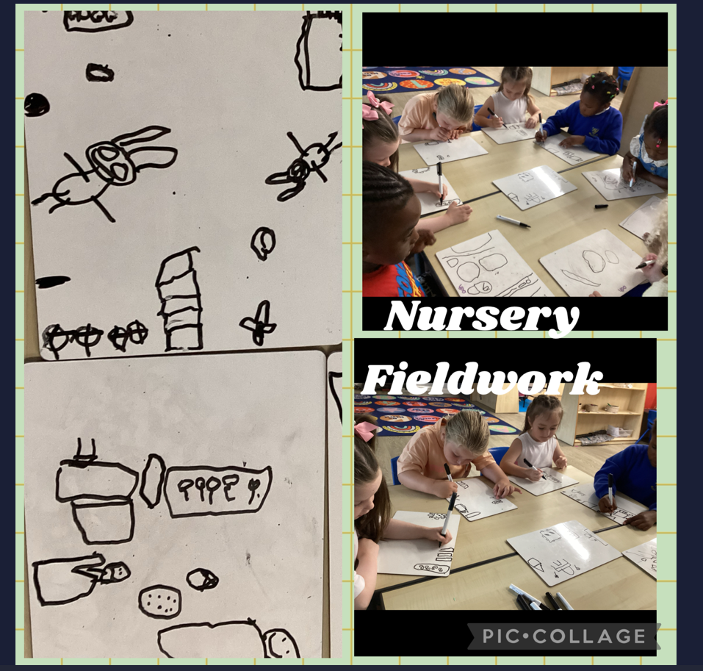
Nursery
Our youngest geographers explored their classroom environment by creating maps of the features and objects they could see. They developed their early mapping skills by using positional language to describe the location of items, building their understanding of space, place, and direction.

Slide 4
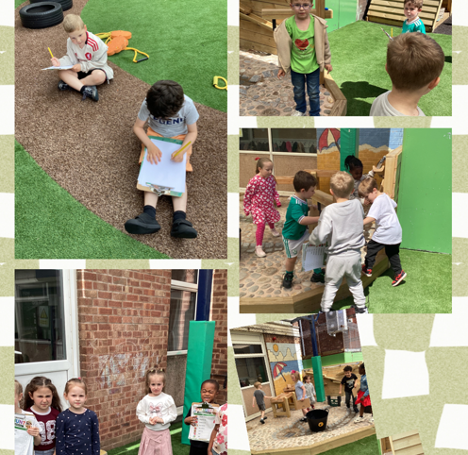
Reception
Reception became enthusiastic young geographers through exploring and investigating their outdoor environment. Using simple maps, they identified and discussed key features of the outdoor area before sketching their favourite places. They developed their understanding of location and direction through a toy hunt, using positional language to describe where objects were found. The children also followed a route around the outdoor space and then recreated it through their own maps, developing early mapping, observation, and navigation skills.

Slide 5
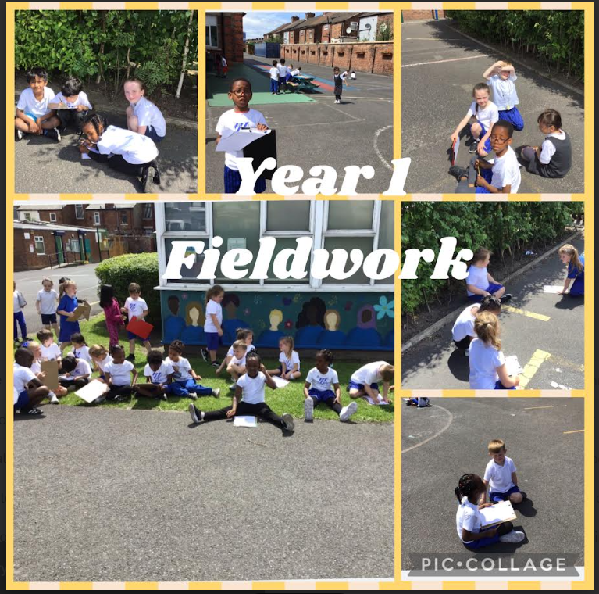
Year 1
As part of their geography fieldwork, Year 1 explored the school grounds and created a map key to represent important features of their environment. This activity helped children develop their mapping skills, understand symbols, and recognise how real places can be represented on maps.

Slide 6
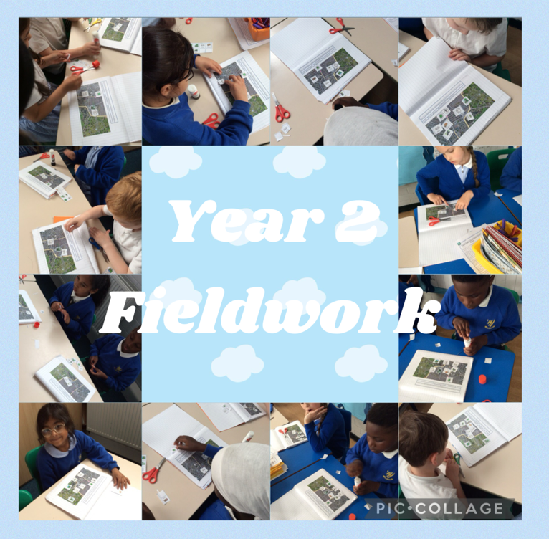
Year 2
Year 2 enjoyed exploring the local area using Google Maps to investigate the physical features surrounding our school. They developed their geographical understanding by identifying and discussing features of the local landscape before using their observations to create their own maps. The children applied their map-making skills by using symbols and keys to represent real-world features accurately.

Slide 7
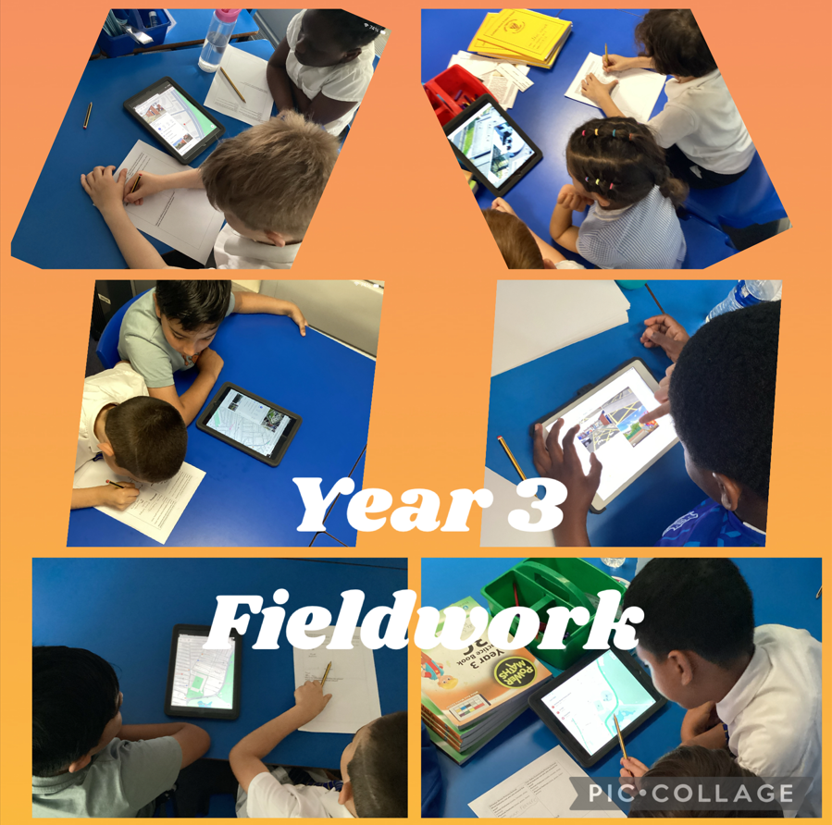
Year 3
Year 3 conducted primary geographical fieldwork within our school locality. The children collected data to contrast local human and physical features with Four Oaks. The study strengthened their environmental analysis and observational skills.

Slide 8
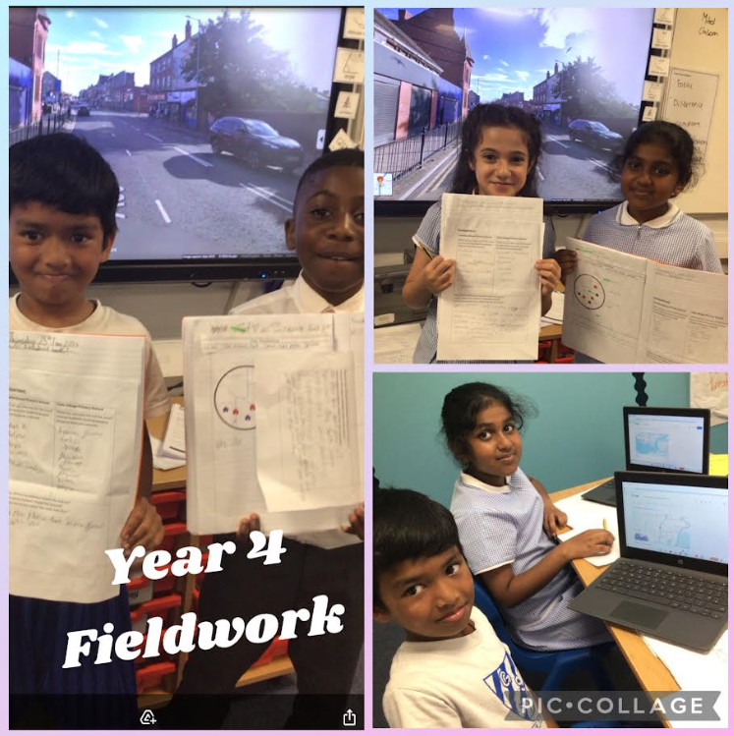
Year 4
Year 4 compared our local area of Walton to Hale Village. We went outside to investigate how our busy town of Walton looks different from the quiet countryside in Hale Village. They discovered that Walton has lots of shops and terraced houses, while Hale Village has open fields and famous thatched cottages.

Slide 9
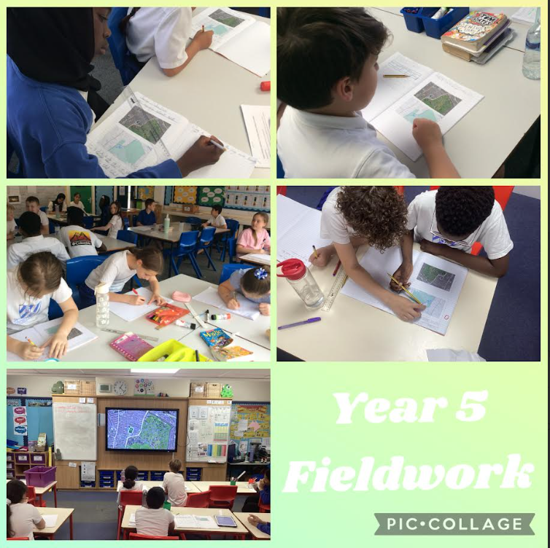
Year 5
As part of their geography fieldwork, the children enjoyed using two different maps to explore and map a route around the school grounds. This activity helped them develop their map-reading skills, use geographical vocabulary, and understand how maps can be used to navigate and represent real-world locations.

Slide 10
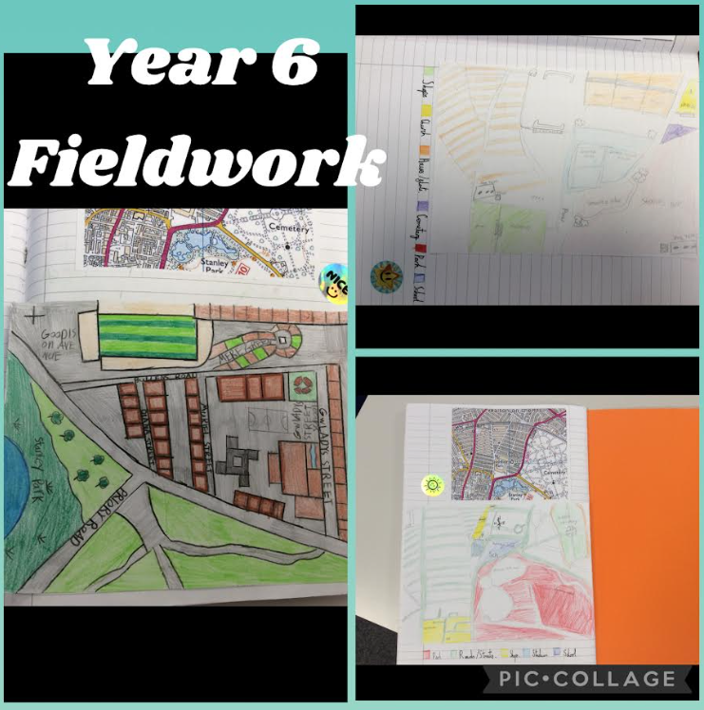
Year 6
As part of their geography fieldwork, Year 6 used a guidance sheet to develop their understanding of using the eight compass points before applying these skills independently. Working collaboratively, they designed detailed maps of their local area, using accurate directions, symbols, and geographical features to create clear and informative representations of the places around them. This activity strengthened their map-reading, navigation, and fieldwork skills.

