Slide 1


Welcome to Gwladys Street Community Primary and Nursery School
Notes:
1
Firstly thank you for choosing gwladys street It will not be long until your child will be starting school at Gwladys Street. There will be lots of new things to learn and of course you will want to ensure that your child is well prepared for this important event. We aim to make it a happy and memorable experience and today we hope to provide you with some useful information that will help your child settle quickly into school life.

Slide 2
Our aims for today ..
To become more familiar with the EYFS team and the learning environment
To understand our school expectations
To learn about how you can support your child with phonics and reading
To understand the importance of attendance and good communication with school
To give you an overview of the Reception Year
To help you prepare for September
To answer any questions or queries you may have

Slide 3
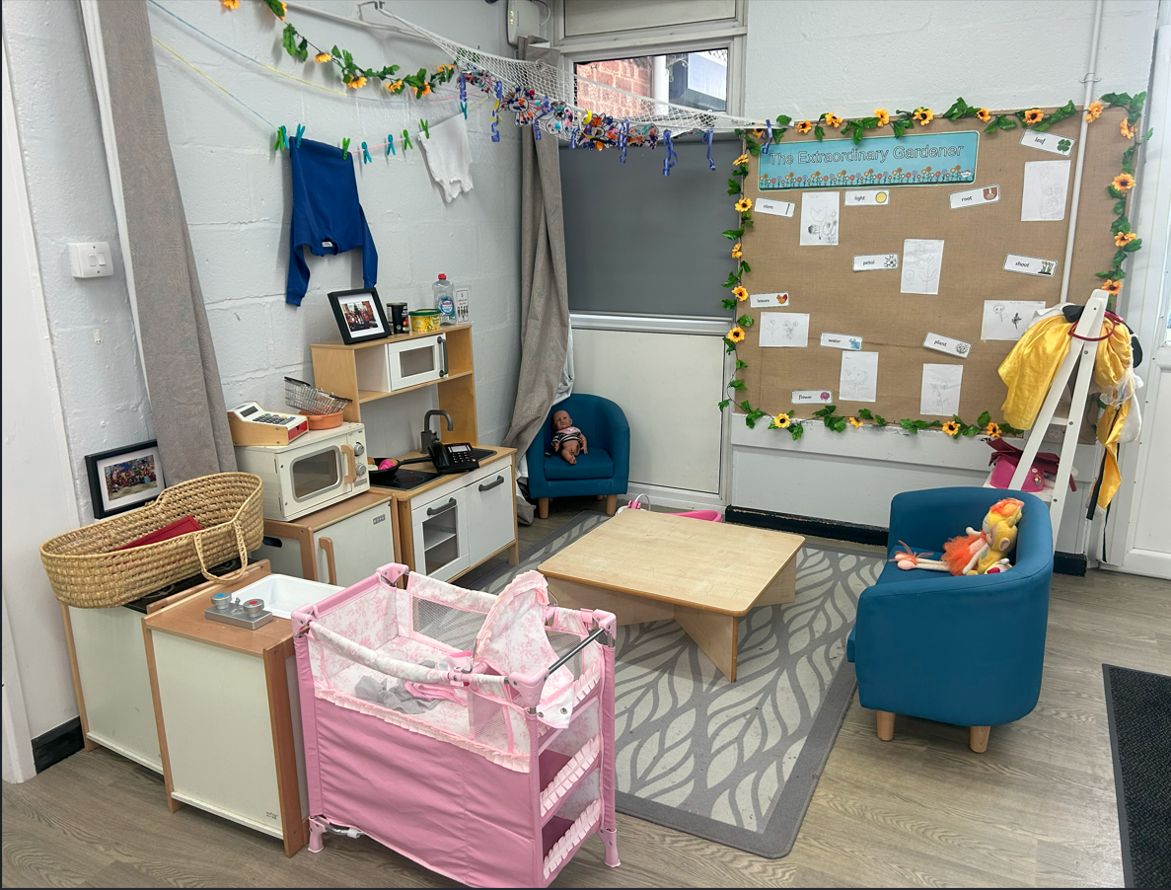
Welcome to Gwladys Street Community Primary and Nursery Foundation Base...
Notes:
In order to ensure that we meet your child’s learning needs we currently operate as an EYFS base. This provides us with the opportunity to support your child individually and for them to access learning at a level that is appropriate for them.

Slide 4
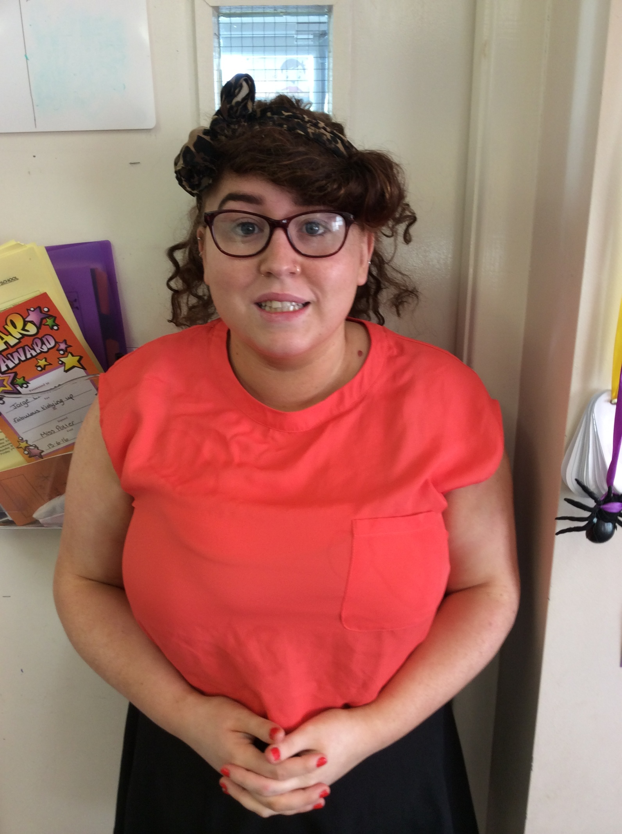
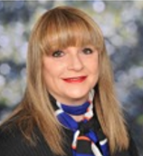

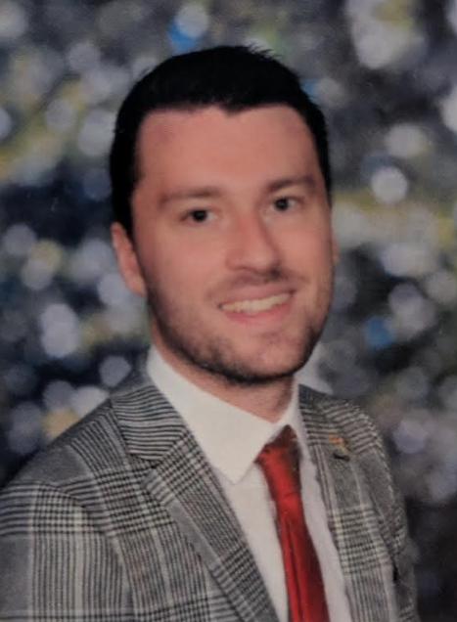

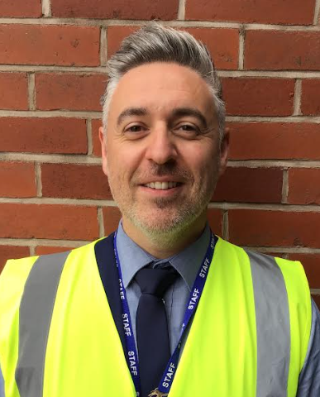

Key People – Leadership and Management
Ms Booth
Head Teacher
Mr Moore
Deputy Head Teacher
Mr jones
SENCO / Assistant Head teacher
Mr morris
Assistant Head teacher
Miss Hennessey
Early Years Lead Teacher
Mrs upton
Designated Safeguarding Lead

Slide 5
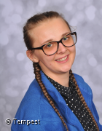


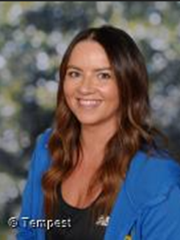
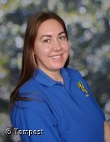
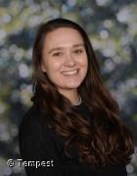
Reception Staff
Miss Gallie
Reception Class Teacher
Mrs Rimmer
Reception Class Teacher
Miss Hennessey
EYFS Lead Teacher
Miss richardson
Key Worker
Miss brierly
Key Worker
Miss Timmins
Key Worker
Miss manuel
Key Worker

Slide 6



Our Office Staff
Mrs Greenall
Miss Cunningham
Mrs Hargreaves

Slide 7
Induction Process
Prior to starting Reception who are new to gwladys street:
Home visit for all children
nursery visit for all children who currently attend another setting
weekly stay and play sessions
For children who currently attend Gwladys Street Nursery:
attending new classrooms with miss gallie
attending new classrooms with reception staff
September…
Children from Gwladys Street nursery attend the same hours as nursery for the first week.
children new to gwladys street will attend from 8.50-12.00 for the first week or 12.30-3.30pm
Notes:
7
(Read slide) We are really looking forward to meeting and working with you and your family..

Slide 8
EYFS Values and Vision
Stimulating learning opportunities both indoors and outdoors through our enabling environment.
High quality interactions through excellent practice and provision.
Support parents with information to support learning at home through stay and play sessions, parents evening and weekly updates.
Every child feels valued as an individual.
Support the wellbeing of our children and enable them to become confident, resilient and independent learners.
Foster a life time love of learning through and inclusive and personalised curriculum
Notes:
Read slide

Slide 9
Early Years Foundation Stage Curriculum
The Prime Areas:
• Communication and Language
• Physical Development
• Personal, Social and Emotional Development
The Specific Areas are:
• Literacy
• Mathematics
• Understanding the World
• Expressive Arts and Design
Notes:
9
READ Slide

Slide 10
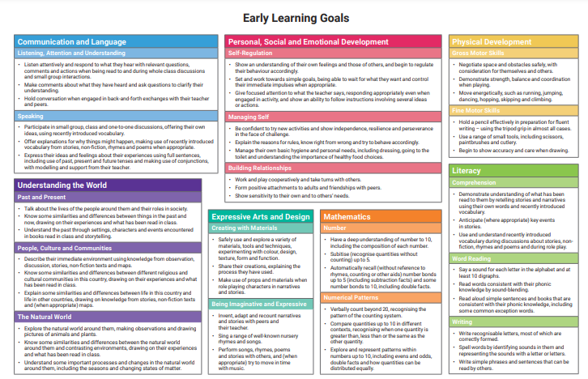
Early Learning Goals
Please find a copy of the Early Learning Goals that your child is expected to meet at the end of July 2027

Slide 11
Our expectations..
Children attend school every day
Children arrive to school at 8.50
Children come to school dressed in full school uniform
Your child reads at least five times per week
Attend our termly stay and plays if possible

Slide 12
Ways to support Reading, writing and storytelling
Please read daily with your children.
Ask your children to turn the pages and talk about what they can see happening in the pictures.
Ask them to spot letters from their name.
Make up stories with your children when you are walking to school.
Sing Nursery rhymes regularly.
Use toys and puppets as characters to bring stories alive.
Please speak to your child’s key person or class teacher if you would like any support with reading.
Notes:
(Read slide) School will also provide stay and play opportunities for you to come along and learn more about reading in the Early Years. We follow the Read Write Inc programme from FS2 upwards and children will only be provided with Library books until they know a number of letter sounds. this is in order to develop confidence when reading.

Slide 13



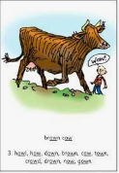

Read, Write, Inc.
Phonics - the sounds that our alphabet represent.
We have 26 letters, 44 sounds and many more ways of writing those sounds.
or au aw ow ow
for Paul yawn cow snow

Slide 14
Read, Write, Inc.
By the end of Reception, it is expected that all children can read 25 single letter sounds as well as 10 ‘special friends’
Sh ch th nk ng ss ff ll zz ck qu
It is also expected that children can read simple ‘irregular’ words such as ‘the’, ‘I’, ‘no’, ‘go’.

Slide 15
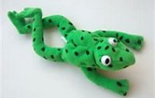
Blending Sounds
Once the children have learnt some sounds they can start to blend them to begin to read words.
Fred the Frog helps us to learn our sounds!
He only speaks in sounds!
He helps the children listen to the sounds and begin to blend the words without reading them.
Try ‘Fred talking’ at home to
Prepare your child for September.

Slide 16
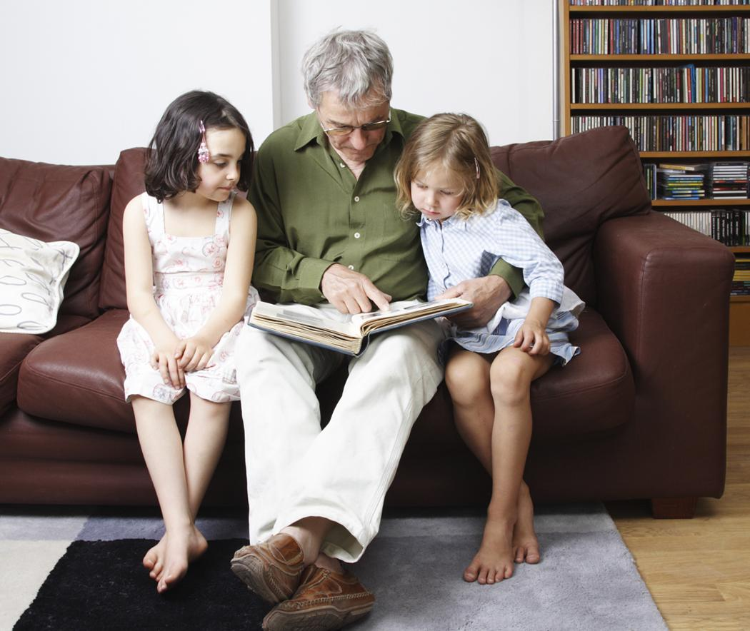
Home reading
5 - 10 minutes
Take turns
Quiet place
Make reading enjoyable

Slide 17
Home learning- When and What?
Home learning will be:
Daily
To read for 5 to 10 minutes every night.
Read to your child each night.
Every Friday
An update of what we have been learning in school with ideas how to support at home.
Maths / Literacy homework

Slide 18
What should my child be doing now and what can I do to support?
Children should be able to listen and pay attention to adults for 5 to 10 minutes – this could be reading a story.
Recognise and put on their own coat including the zip.
Ask for help when needed – Avoid doing it for them without asking.

Slide 19
What should my child be doing now to support Literacy and what can I do to support?
Enjoys books and stories, listening attentively, joining in with rhymes and talking about pictures and familiar events.
Develops early reading skills by recognising their name, identifying some letters and beginning to hear the initial sounds in words.
Begins to communicate through mark making and early writing, giving meaning to their drawings and marks while developing the skills needed for reading and writing in Reception.

Slide 20

What should my child be doing now to support Mathematics and what can I do to support?
1 | I can recite numbers to 5 and show up to five on my fingers
2 | I can count up to 5 objects
3 | I can recognise numerals to 5
4 | I can match numerals to quantities to 5
5 | I can recognise groups of up to 4 without counting (subitising)
6 | I can solve simple practical problems involving "one less"
7 | I can compare groups and say which has more
8 | I can copy an AB pattern
9 | I can recognise common 2D shapes in the environment
10 | I can explore differences in size, length, weight and capacity.
11 | I can respond to some special and positional language such as ‘in’, ‘on’, ‘next to’, ‘behind’, "inside" and "outside"

Slide 21
Websites to support
Tiny Happy People
Best Start in Life - Best Start in Life

Slide 22
Early Years Pupil Premium
Would all Reception parents please visit:
https://liverpool.gov.uk/children-and-families/early-years-and-childcare/early-years-pupil-premium-eypp/
and follow the instructions to find out if your child is entitled to pupil premium.
The purpose of completing the registration is to ensure that the school receives additional funding (up to £300) to support your child whilst in school i.e. additional teaching assistants, resources and more!

Slide 23
School Meals
As of September 2014 all children in reception – Year 2 have been entitled to a School Meal which is funded under the New Government scheme.
If you are entitled to certain benefits, then it is still important to apply at the School Office as this will entitle your child to certain benefits in school through the Pupil Premium Fund.
Our school meal provider is Absolutely Catering. All menus are available on our website.
Notes:
23

Slide 24

Absence
If your child is ill, please call the school office.
Miss Cunningham or a member of the Office Staff will call.
Home visits WILL be made.
When your child returns, a letter and medical evidence must be handed in.
All children MUST be in school EVERY day.
we do not routinely authorise holidays during term time. Unauthorised holidays may result in a fixed penalty notice.
Notes:
24

Slide 25

Attendance
‘Every second of every day counts!’
97% - 100% attendance Green Letter
Best chances of success. FANTASTIC!
91% - 96% attendance Amber Letter
Poor with cause for concern. NEED FOR IMPROVEMENT
90% and below attendance Red Letter
Very poor with serious concern
DANGER ZONE PERSISTENT ABSENTEE.
Notes:
25

Slide 26
Appointments
Please inform the school office and the class teacher.
Please try and get appointments outside of school hours.
Parents/carers should provide proof of the appointment e.g. by presenting a letter or appointment card.
Parents/carers will be given a pass by the school office which shows authorisation/knowledge of being out of school.

Slide 27
Behaviour
At Gwladys Street we use TEAM
T – Trust, listen and respect
E – Enjoy everyday
A – Achievement for all
M – Making everyone feel
welcome

Slide 28

SECURITY / SAFEGUARDING
School has robust security procedures.
All gates locks during the school day.
If you need to come into the school during the day to collect your child for an appointment, you need to inform the school before hand.
you should enter the site via the gate at the top of Gwladys Street (there is a video intercom system on this gate). Parents/Carers should then report immediately to the main office in the Infant Building.
All children leaving early MUST be signed out at the office before leaving school.
All school staff have an obligation to challenge people they see on or around school property.
If a different person is collecting your child, please inform your class teacher or call the Office. You must provide the adults full name and relationship to the child. Staff will not let your child go with anybody unless they have been informed.
Password System: School operates a password system. If someone different is collecting your child from school the class teacher MUST have been given a message and the unfamiliar person MUST provide a password, without the password your child will NOT be allowed to go home with someone different.
Notes:
28

Slide 29
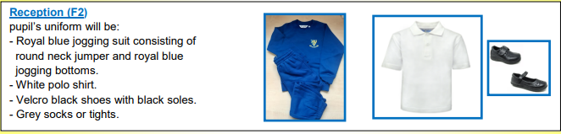
School Uniform

Slide 30
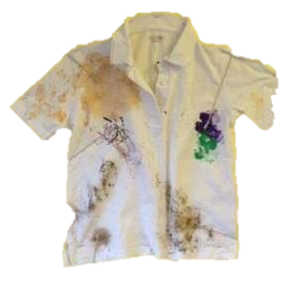
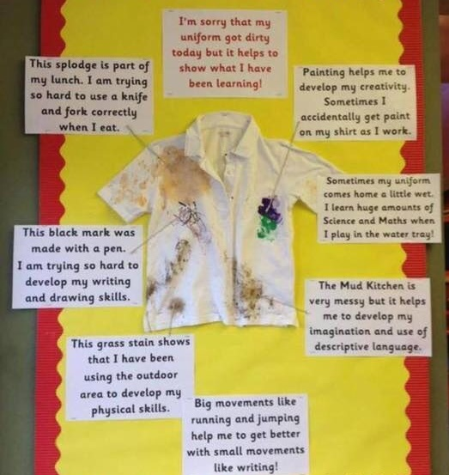
What might this mean for you?
We always try to encourage children to use an apron!

Slide 31

Breakfast Club
Breakfast Club on site (register your interest with the School Office)

Slide 32

Contact numbers
It is vital that if you change any telephone numbers or address details that you inform your Key Worker and the Office.

Slide 33
Parent/ Carer Conduct
If you have an issue that you wish to discuss then please inform your child’s teacher immediately so that the appropriate support and actions can be taken. A meeting will be set up within 48 hours
Please do not discuss issues regarding other children on the playground.

Slide 34

Let’s Talk Toilet!
To meet your child’s developmental needs it is expected that all children are fully toilet trained by the time they start school. If your child isn’t, then you have the whole Summer holiday to get that sorted!
Here’s what we assess your child on with regard to your child’s toileting;
Range 5 - F1 - “Working towards a constant daily pattern in relation to … toileting …”
Range 6 - F2 - “Usually dry and clean during the day.”
If your child has a medical condition regarding toileting please contact the office and provide the necessary paperwork so we can put a Intimate Care Plan in place for them!
Please note the words “working towards” and “usually”, it is not uncommon for your child to have accidents so don’t worry! We’re good at supporting them to change themselves and meet their own personal hygiene needs.

Slide 35
Setting your child up for success!
Label EVERYTHING with your child’s name.
Buy a uniform that’s a little bit bigger for your child.
NO SHOE LACES
Your child will be assessed on their independence skills
Encourage your child to leave all their toys at home.
Increase your child’s independence with dressing and zipping up coats.

Slide 36
Don’t Forget!
Remember the weather changes quickly so send your child in with a coat or jacket.
To make sure your child comes to school with a jumper on.
If it’s going to be sunny and hot please make sure your child comes to school with sunblock already applied.
We go out in ALL weather so make sure your child has warm clothes in winter. However, we provide waterproofs and wellingtons.
If your child is prone to toilet accidents, then please send in a change of clothes.

Slide 37
www.gwladysstreet.com
Parents App
Instagram
Learning Journals
Thank you for choosing Gwladys Street. We are sure that your children will go on to achieve their best, make friends, have fun and develop a life-long love of learning!

